Slide 1
Build an event management using salesforce

Slide 2
AGENDA
Introduction
1.1 Overview
1.2 Purpose
Problem Definition & Design Thinking
Result
Trailhead Profile Public URL

Slide 3
5. Advantages and Disadvantages
6. Applications
7. Conclusion
8. Future Scope

Slide 4
Introduction

Slide 5
1.1 OVERVIEW
Event management is the process of creating and maintaining an event. This process spans from the very beginning of planning all the way to post-event strategizing.
At the start, an event manager makes planning decisions, such as the time, location, and theme of their event. During an event, event managers oversee the event live and make sure things run smoothly. After an event, event managers are tasked with reviewing event data, submitting KPI and ROI findings, and staying on the ball for any post-event offerings.
All different branches of planning go into event management, including various types of sourcing, designing, regulation checks, and on-site management. In event management, you could be in the process of creating a conference, a product launch, an internal sales kick-off, or even a wedding. Really, any event that requires considerable planning and execution is event management.

Slide 6
1.2 purpose of event management
All in one event management software
Time saving
Event automation
4. Increase engagement rate at events
5. Access to valuable real time data
6. Personalized reports for continous improvement

Slide 7
Problem definition & design thinking

Slide 8
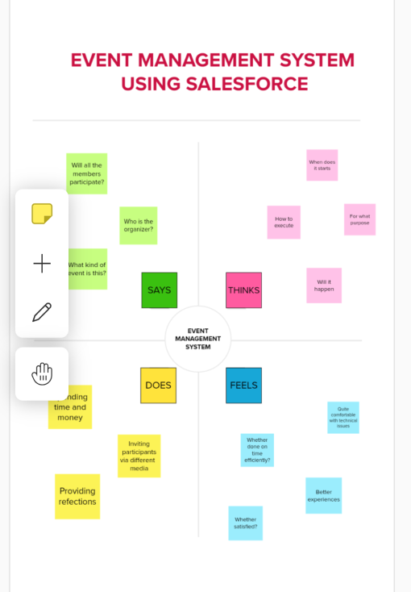
2.1 empathy map

Slide 9
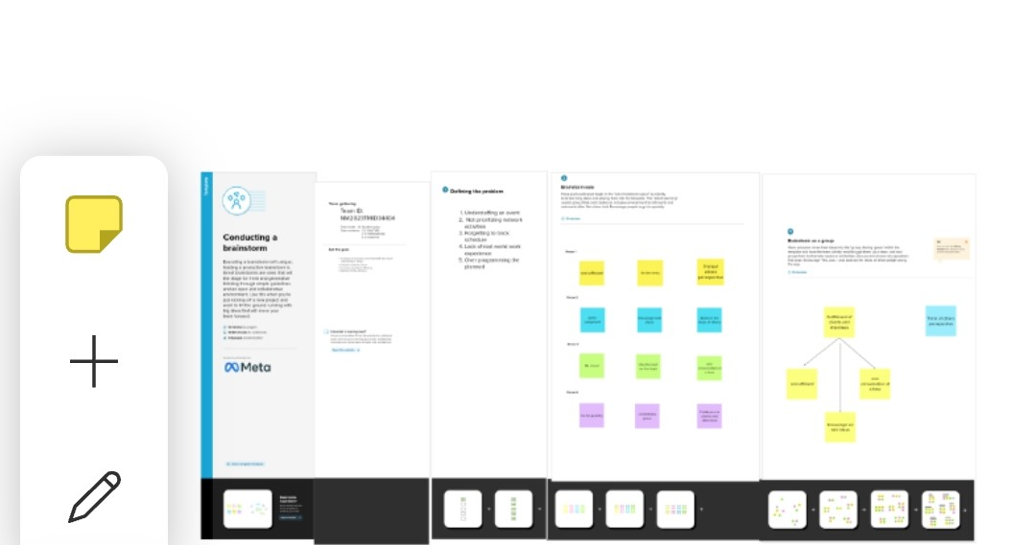
2.2 brainstorming

Slide 10
Result

Slide 11
3.1. data model
OBJECT NAME | LABEL | DATA TYPE
Event | Event | Text
Attendee | Attendee | Text
Speaker | Speaker | Text
Vendor | Vendor | Text

Slide 12
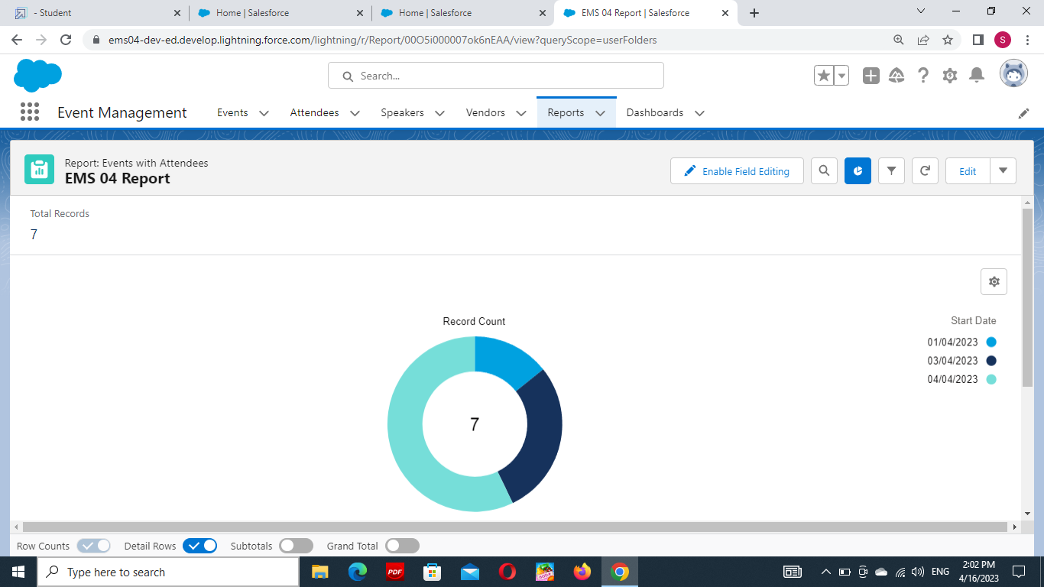

Slide 13
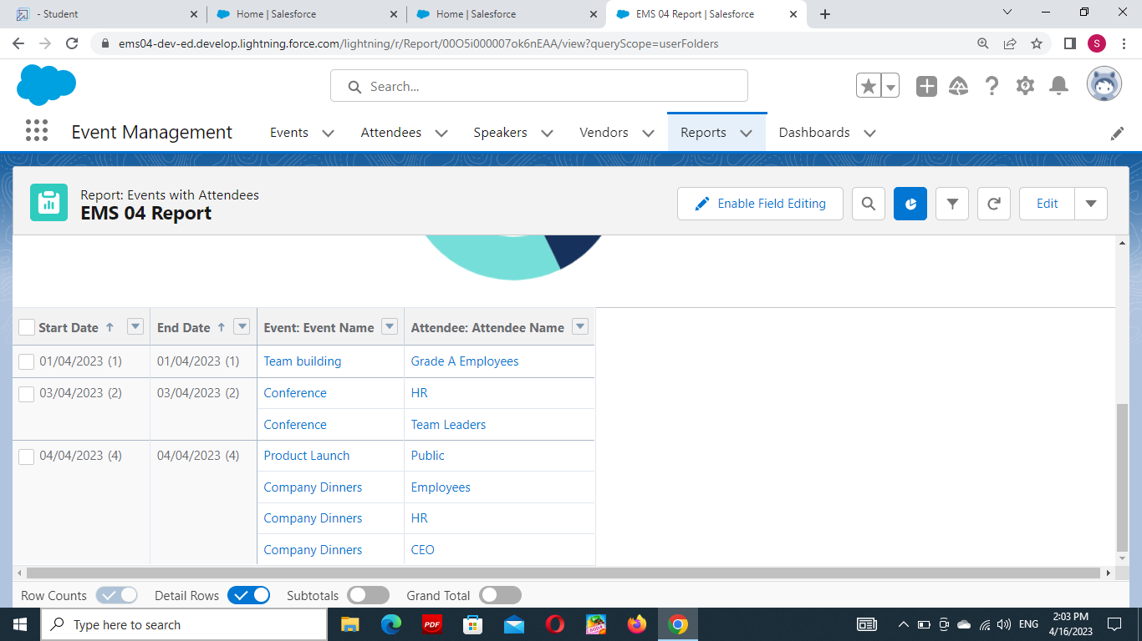

Slide 14
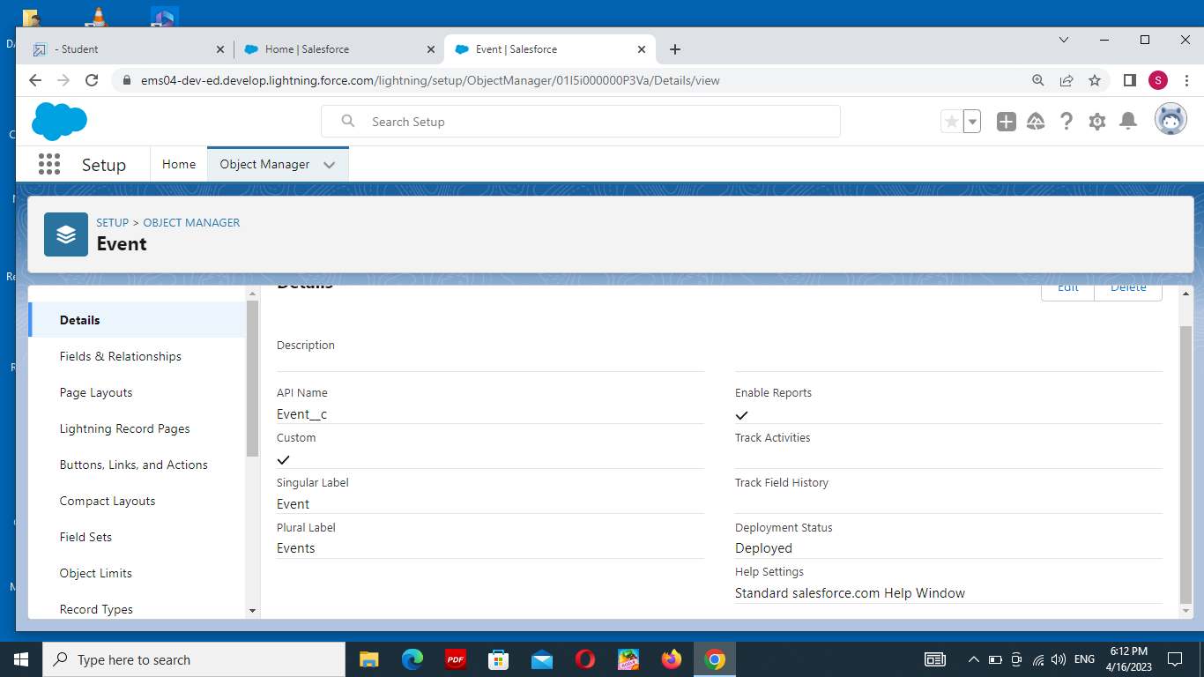
event

Slide 15

attendee

Slide 16

speaker

Slide 17
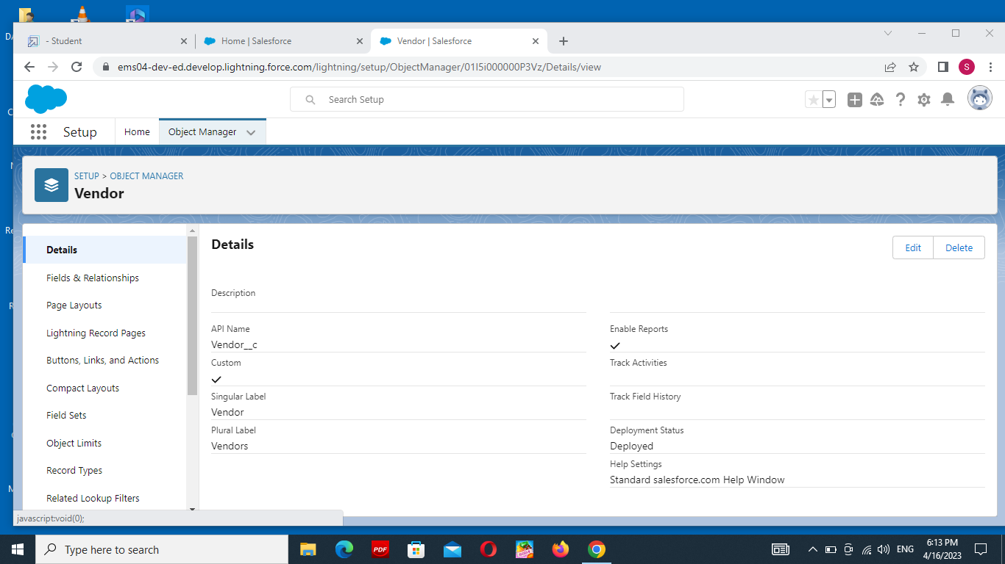
vendor

Slide 18
4. Trailhead profile public url

Slide 19
Trailhead profile public url
Team lead – https://trailblazer.me/id/shanb31
Team member 1 – https://trailblazer.me/id/savid6
Team member 2 – https://trailblazer.me/id/ssrisri
Team member 3 - https://trailblazer.me/id/vaniv13

Slide 20
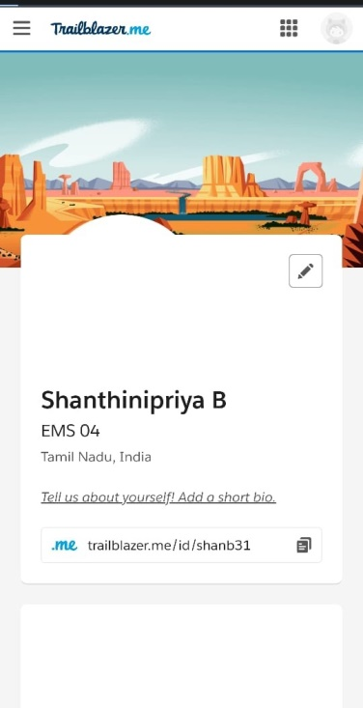

Slide 21
5. Advantages and disadvantages

Slide 22
1.Opportunities for creativity. 2. Ability to work on different events. 3. Few educational requirements.
ADVANTAGES

Slide 23
advantages
1. Opportunities for creativity:
As an event manager, you can use your creative skills and talents to coordinate the details of parties and celebrations.
2. Ability to work on different events
An event manager often works on several types of events. For example, they might plan a business conference, holiday party, music festival or product launch
3. Few educational requirements
This profession has few educational requirements for event managers to start their careers.

Slide 24
disadvantagess
Unconventional work hours
Time away from family and friends
High level of responsibility

Slide 25
disadvantages
1.Unconventional work hours
Event managers often work nights and weekends to complete their responsibilities, sometimes in addition to normal office hours during the weekdays.
2. Time away from family and friends
Event planners might travel often to manage their tasks. This can result in time spent away from friends and family members.
3. High level of responsibility
Event managers are responsible for helping clients plan successful events. This includes resolving any problems that occur in the planning or execution of an event. For example, if a hired vendor is unable to perform their role in an event, you might help find a replacement.

Slide 26
applications

Slide 27
.
THEY MAKE IT LESS STRESSFUL
It goes without saying that organising an event, no matter the type of size, it is going to be stressful. There is so much to think about, to consider and to plan for, so, you may find that over time it all gets a little overwhelming.
THEY ENSURE IT RUNS SMOOTHLY
Despite the best planning, there are still things that can go wrong during an event. You may not be aware of the problems that can arise or the issues that can crop up. Which means that mistakes all too often happen, and you may not know how to fix them.
THEY TAKE CARE OF THE LEGALITIES There are lots of legal requirements and guidelines that can go along with holding an event. THEY HAVE THE RIGHT CONTACTS You are likely to not only need to book a venue for your event, but also entertainment, caterers and other suppliers

Slide 28
future scope

Slide 29
Future Prospects in Event Management
Nowadays, there is a requirement for an event manager in almost every field like in corporate sector, hotel industry, tourism, fashion industry, film and media industries, social events etc. the talented youngsters can either work as a professional or set up his/her own business. Professionals in this field also get the opportunity to showcase their talent at international levels where delegates from our country participate in cultural festivals and exchange programs, trade shows, conferences, exhibitions, corporate events and so on. A successful event manager can earn in lakhs and cores. So, the demand for creative and talented event managers is never ending.

